Slide 1
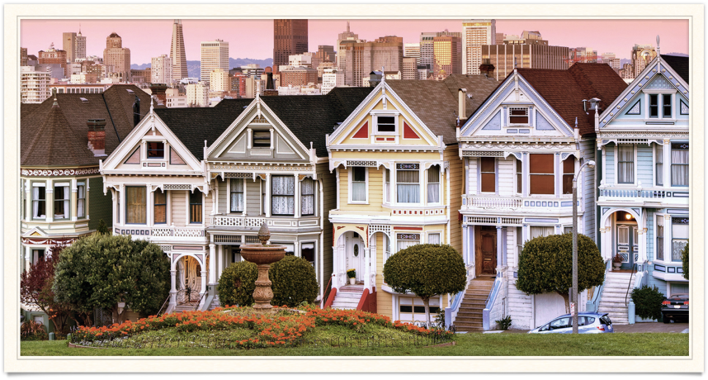
CautiousTenant
Team: Storm
Members: Sijia He, Jiacan Huang, Sijia Zhu

Slide 2
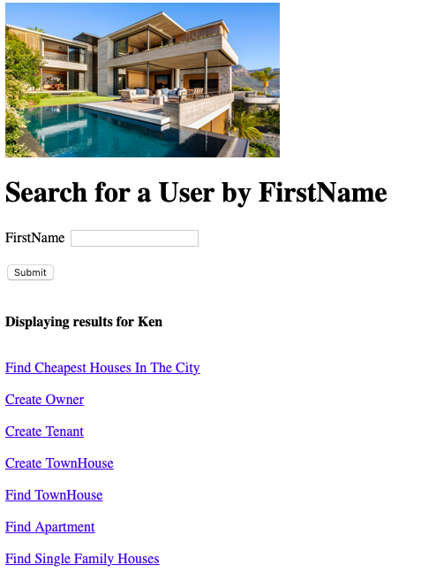

Our Product
A house review application
that provides …
Basic information for houses and users
Crowd-sourced reviews
Reserve, Recommend and Like options
Price comparing service

Slide 3
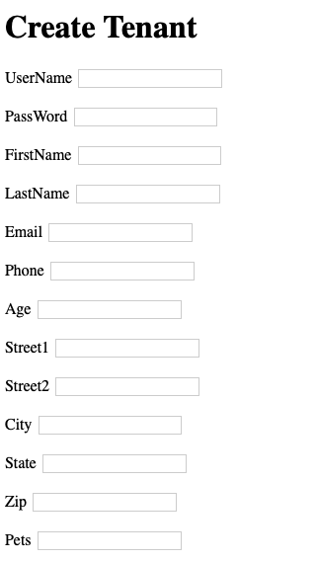
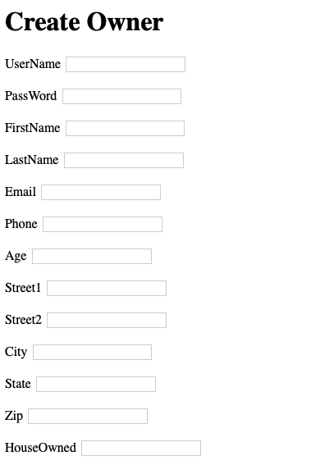
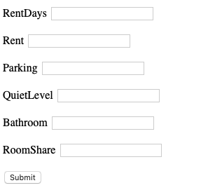

Slide 4
Users can …
Search for housing information and reviews by city
Find a user and see his credit
Find cheapest houses int a certain city

Slide 5
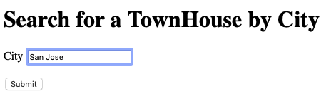
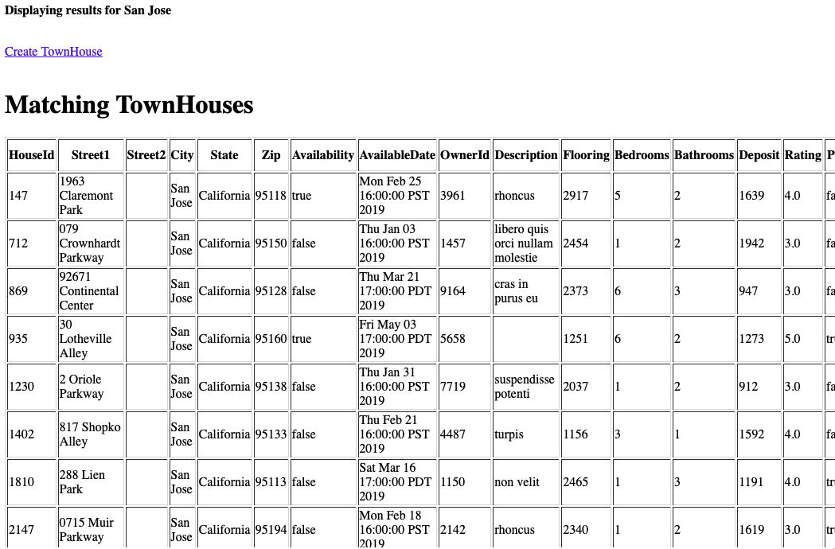
Search for housing information by city
Users can …

Slide 6
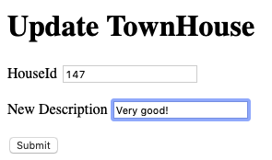
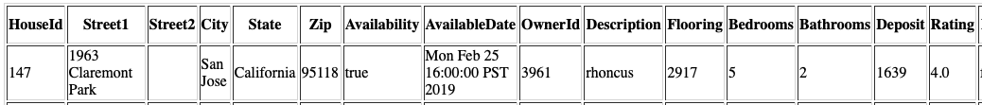
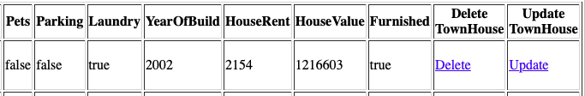

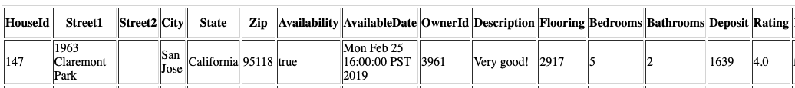
Update or delete a house
Users can …

Slide 7
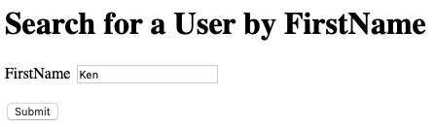
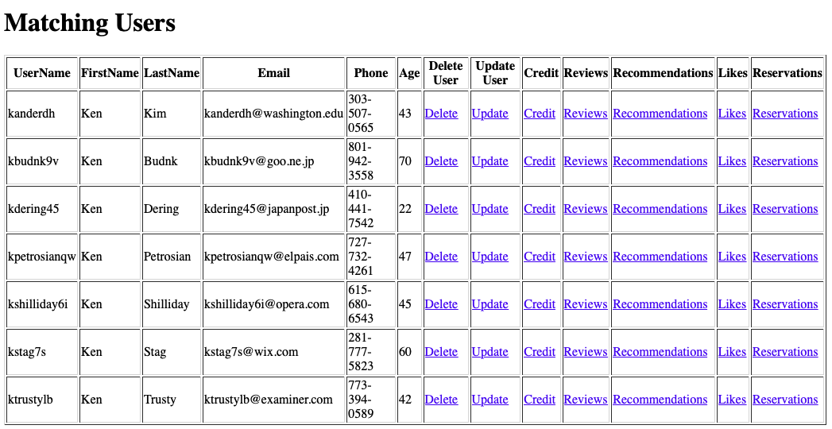
Search for a user by first name
Users can …

Slide 8
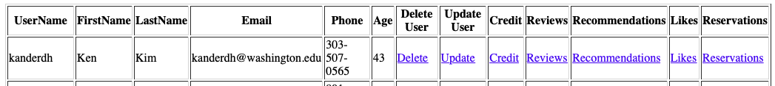
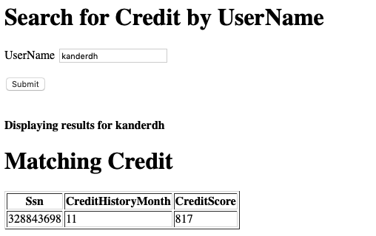
See a users’s credit, Reviews, Recommendations, Likes or Reservations
Users can …

Slide 9
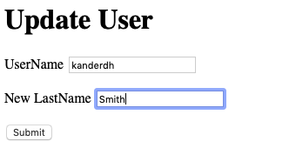
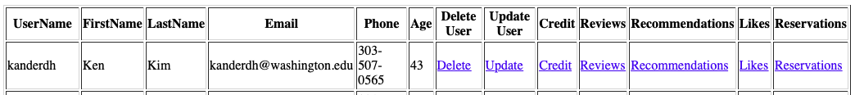
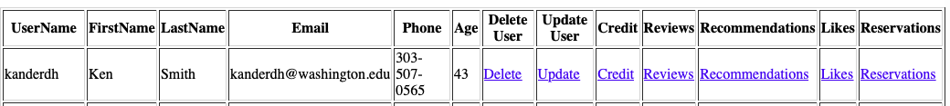
Update or delete a user
Users can …

Slide 10
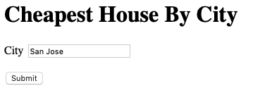
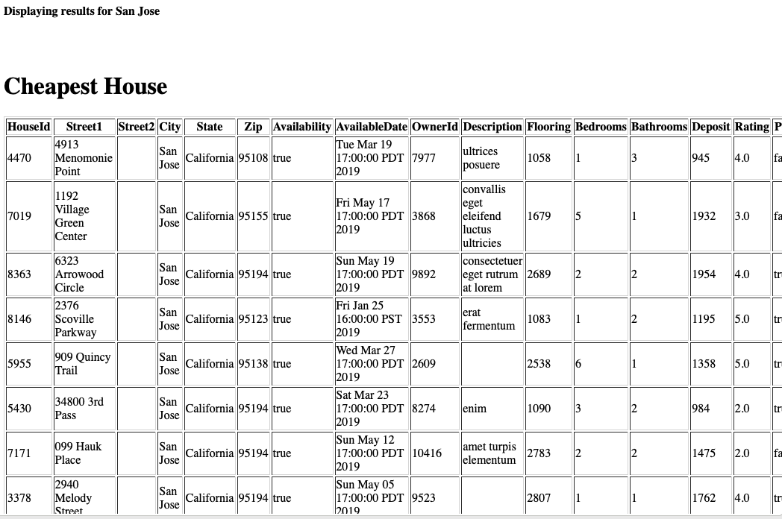
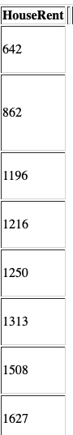
Find 50 cheapest houses in a certain city.
Users can …

Slide 11
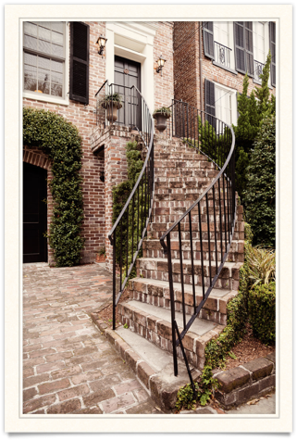
All Milestones
Milestone 1: Definition
Milestone 2: Relational Model and Data
Milestone 3: Business Insights
Milestone 4: Hello World
Milestone 5: Data Warehousing
Milestone 6: Conclusion

Slide 12
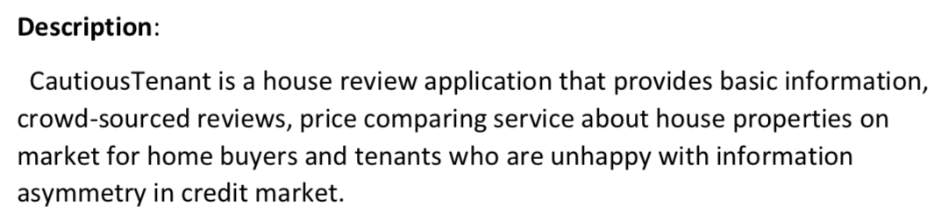
Initial plan

Slide 13
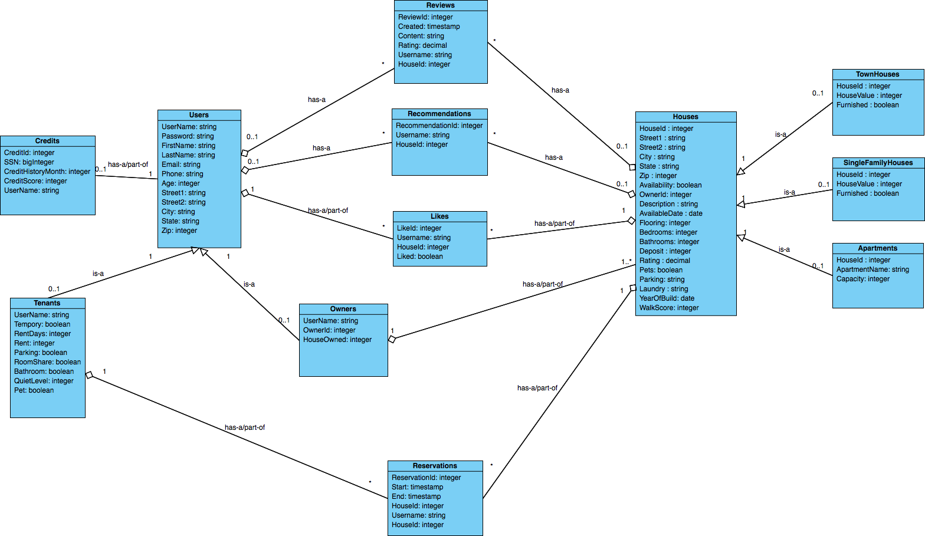
UML

Slide 14




Create tables and insert data
Users;
Owners;
Tenants;
Credit;
TownHouses;
Apartments;
SingleFamilyHouses;
Houses;
Reviews;
Recommendations;
Reservations;
Likes;

Slide 15
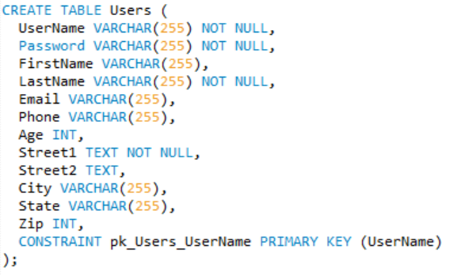
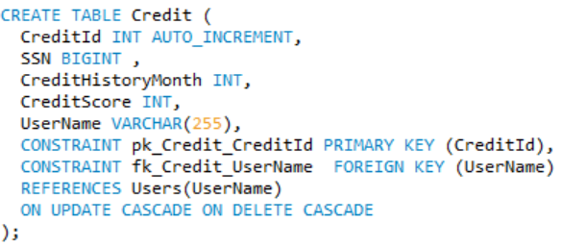
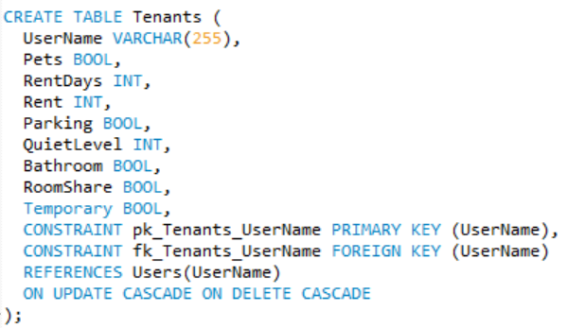
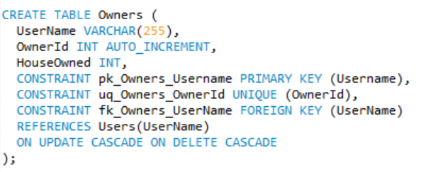
Create table of Users part

Slide 16
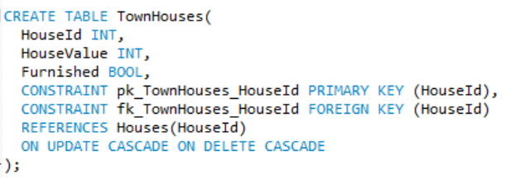
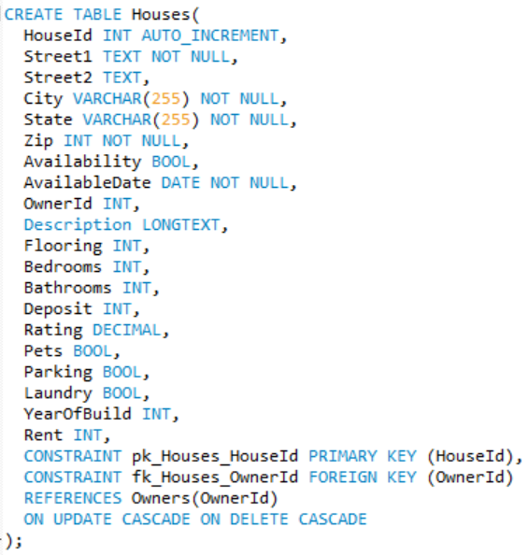
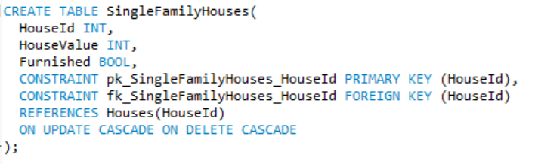
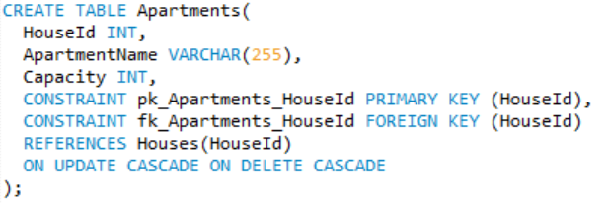
Create table of Houses part

Slide 17
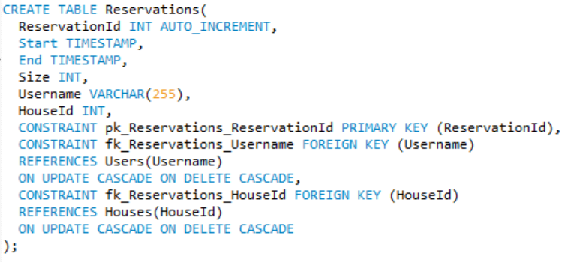
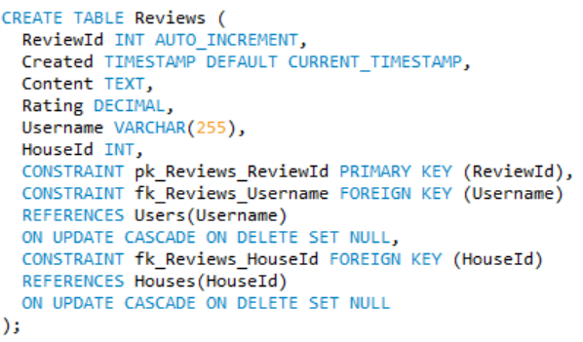
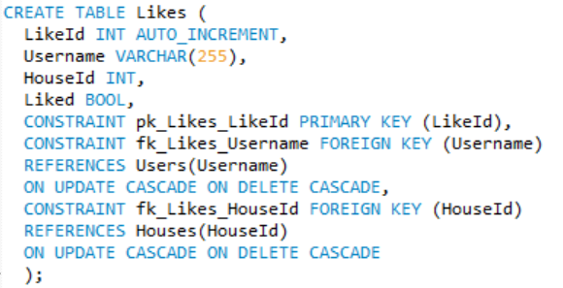
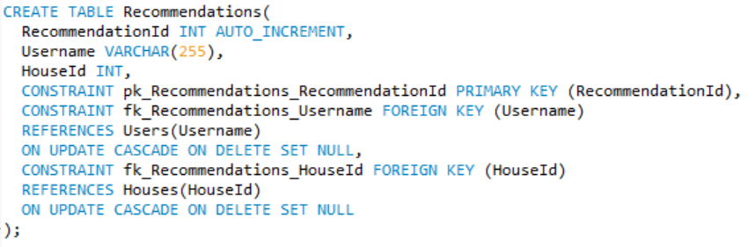
Create table of Altitude part

Slide 18


JDBC/JSP
JDBC (Java Database Connectivty)
JSP(JavaServer Pages)

Slide 19
Structure of JDBC and JSP
JDBC
JSP
MODEL
DAL
SERVLET
Classes
Connection Manager
DAOs :
Create/Read/Update/Delete
Find/ Query/Update/Delete
Do Get
Do Post

Slide 20
Data Analysis
Tax and Apartment Rent
Data sources: California City & County Sales & Use Tax Rates
https://www.cdtfa.ca.gov/taxes-and-fees/sales-use-tax-rates.htm
California Tax Rates by County and City
ETL workflow
Notes:
AA

Slide 21
Data Analysis
GDP and House Price
Data sources:
US Real GDP by Year
http://www.multpl.com/us-gdp-inflation-adjusted/table
GDP of United States by year.

Slide 22
What we plan to do next
Price
Quiet Level
Recommendation System based on users preferences
Pet Friendly
Rent Days Match
Parking
Safety

Slide 23
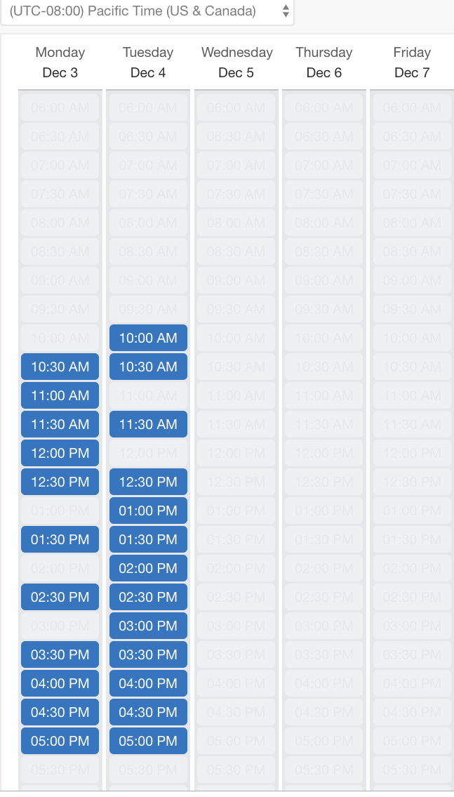
What we plan to do next
Reservation System
Build several slots of times and users can fill in it without too much communications

Slide 24
What we plan to do next
Price Compare System
Order by City
Order by Zip Code
Order by Location :5 Mile
Order by Pet Friendly

